Slide 1
Firefighter Mental Health – A systematic approach Psychological First Aid Critical Incident Stress Management and Debriefing
Peer Support

Slide 2
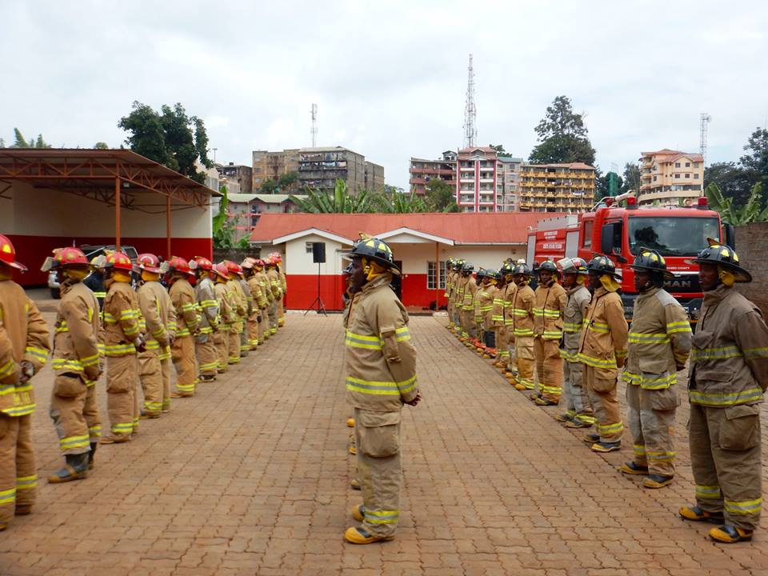
Mission:
Africa Fire Mission is a 501(c)(3) committed to increasing the sustainable capacity of fire departments across Africa. We accomplish this through training, empowerment, support and encouragement
Train
Empower
Support
Encourage
Core Values: + Partnership + Community Ownership + Development + Transformation + Sustainability + Advocacy + Innovation

Slide 4
Introductions – AFM Team
Nancy Moore
Craig Duck
Joe Elliott
Joe Hansen
Donovan Weber
Adam Wolf

Slide 5
Introductions
Name
Rank
What are you hoping we will talk about today regarding firefighter mental health?

Slide 7
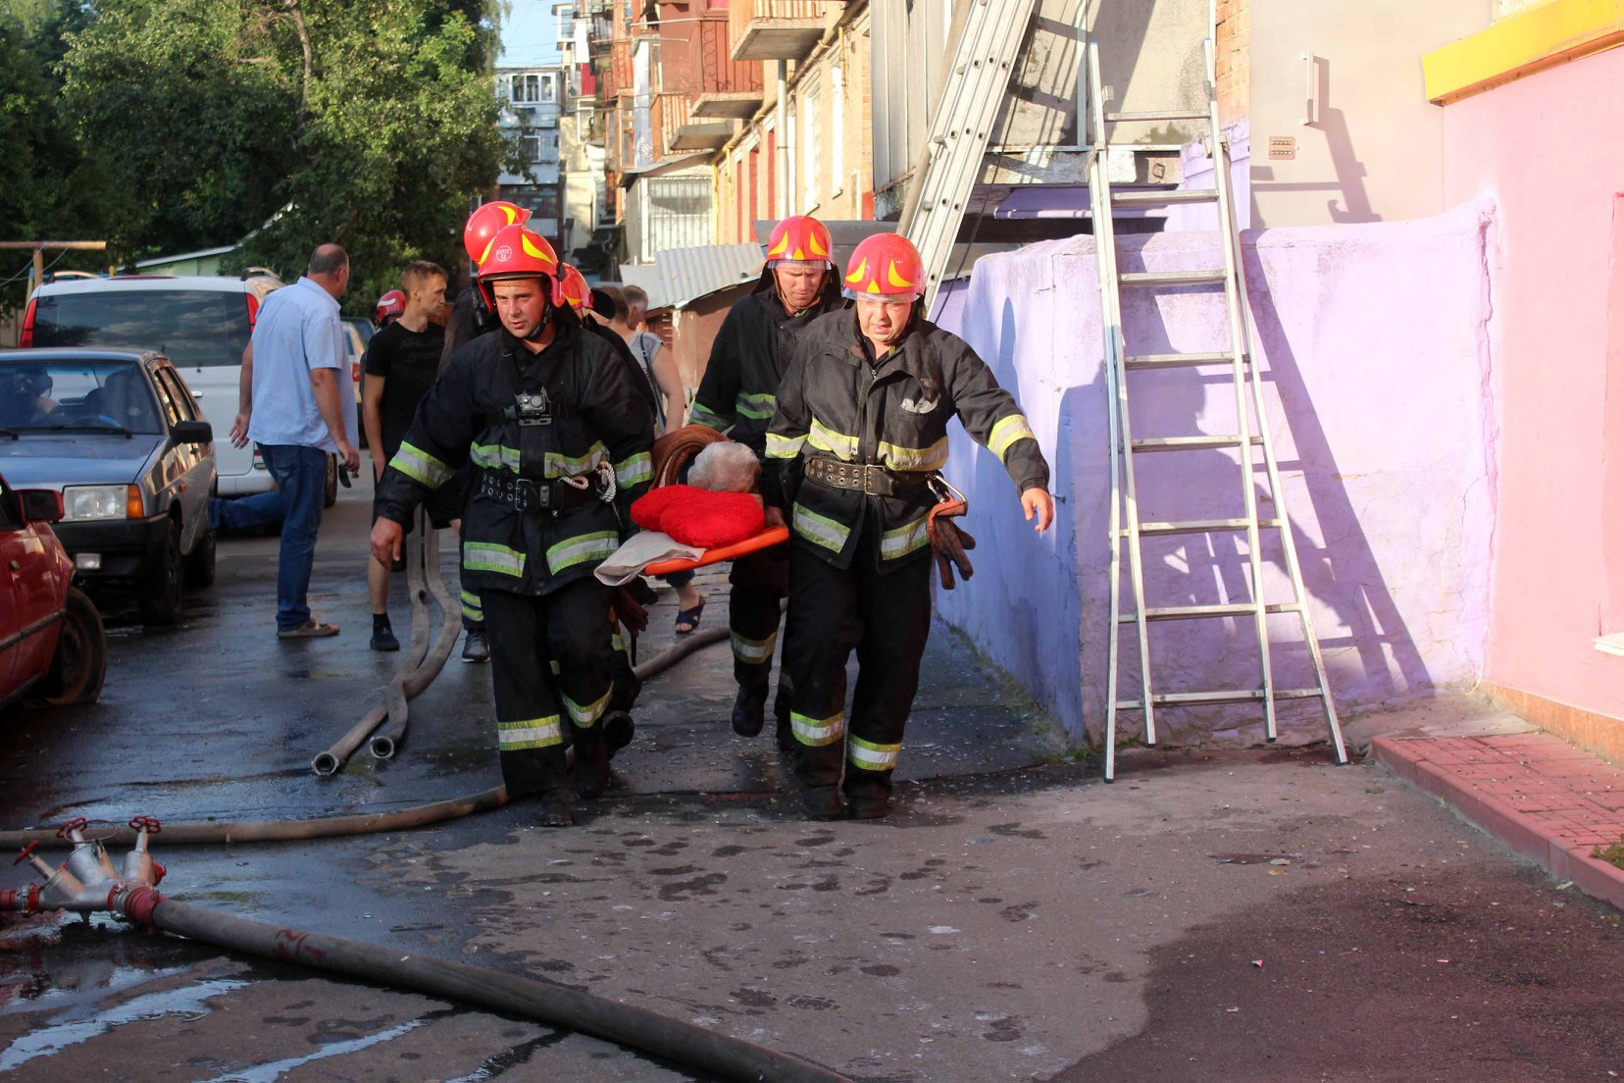
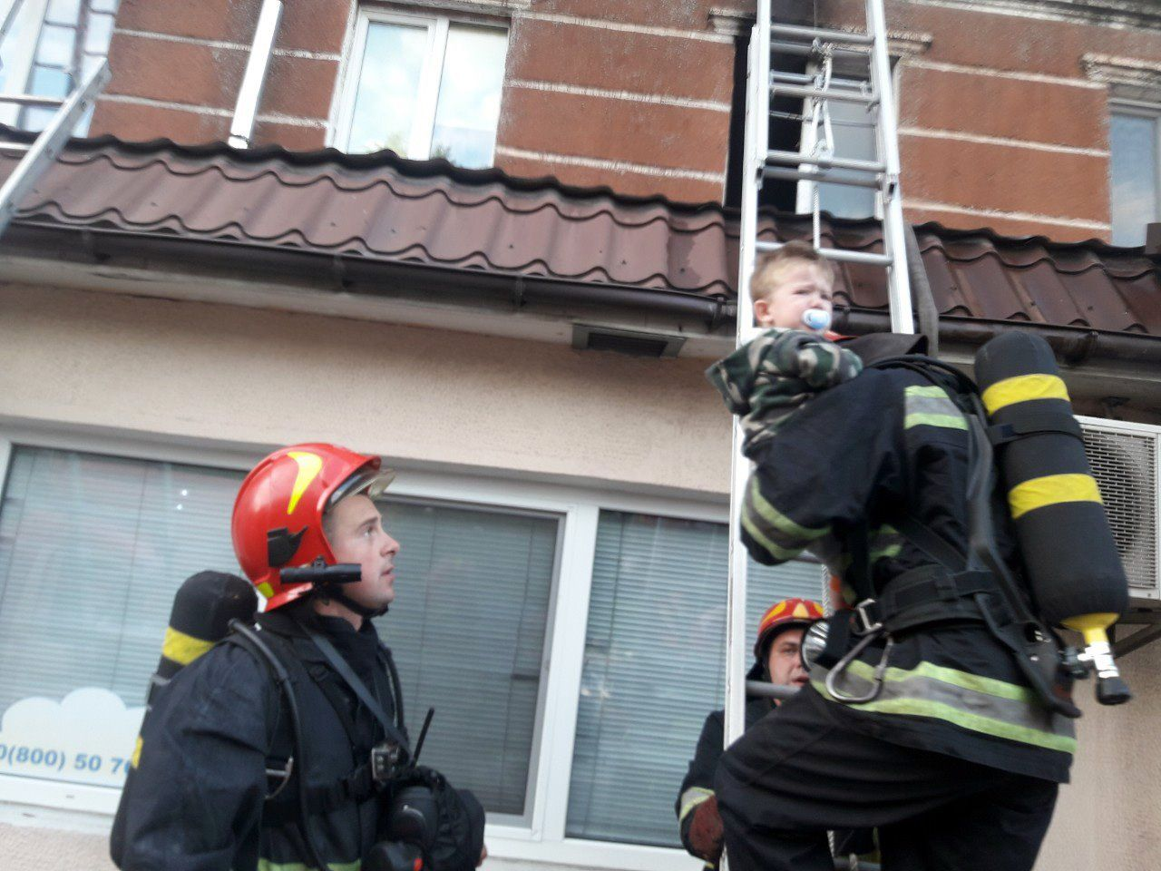
Notes:
Everyday firefighters experience various incidents that can cause stress, cumulitive stress, and secondary trauma.

Slide 8
What is stress?
Stress = difficulty that causes worry or emotional difficulty
Notes:
Is it good, bad?

Slide 9
Physical Effects of Stress
_{Heart problems}
_{Hypertension}
_{Cancer}
_{Ulcers}
_{Diabetes}
_{Chronic headaches}
_{Anxiety-related disorders}
_{Posttraumatic Stress Disorder}
Asthma
Excessive eating
Decreased sex drive
Fatigue
Dizziness
Muscle and back aches
Tics

Slide 10
Behavioral Effects of Stress
Accident-proneness
Anger
Argumentativeness
Blaming others
Drug and/or alcohol abuse
Excessive violence
Irritability
Inability to concentrate
Lack of control
Neurotic behavior
Nail biting
Obsession with work
Rage
Rapid behavior changes
Uncontrollable urges to cry
Withdrawal

Slide 11
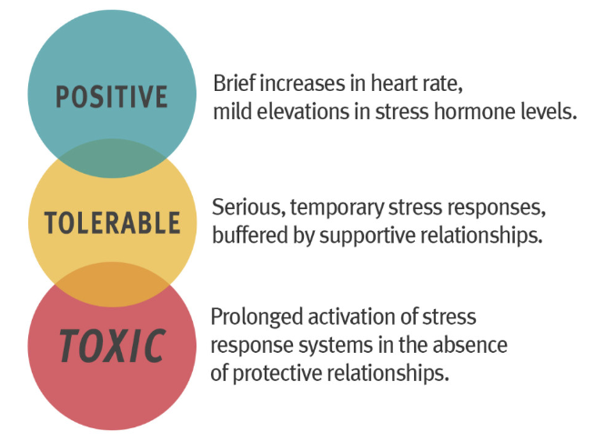
Understanding Types of Stress:
Notes:
Stress decreases when needs are met – briefly discuss Maslow’s Hierarchy of Needs

Slide 12
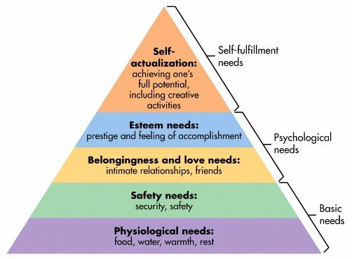
Maslow’s Hierarchy of Needs
Maslow, A. H., Maslow, A. H., & Salenger Educational Media (Firm). (1987). Maslow's hierarchy of needs. Santa Monica, CA: Salenger.

Slide 13
What is burnout?
Burnout = physical, emotional & mental exhaustion caused by long term involvement in emotionally demanding situations
Emotional Exhaustion
Depersonalization
↓feelings of personal accomplishment
Gradually gets worse

Slide 14
Symptoms of burnout
Lack of enthusiasm and interest
Decreased job performance
Temper flare-ups
Loss of will, motivation or commitment

Slide 15
What is Trauma?
Trauma is:
an EVENT, series of events, or set of circumstances that;
is EXPERIENCED by an individual as physically or emotionally harmful or life threatening;
and has lasting adverse EFFECTS on the individual’s functioning and mental, physical, social, emotional, or spiritual well-being.

Slide 16
What is secondary trauma/ vicarious trauma?
Trauma that occurs as a result of stress, burnout and supporting those who have experienced trauma or are particularly vulnerable.
The symptoms are real and cumulative
Psychologically distressing event outside the range of the usual human experience
Symptoms include: Intense fear, terror, helplessness, PTSD symptoms
Symptoms can last long after removing yourself from the situation that created the trauma.

Slide 17
Firefighter Mental Health
What kinds of incidents that you respond to may cause stress, burnout, trauma or secondary trauma for you?
These could be things that you witness or directly experience

Slide 18
Need to shift our thinking
Trauma Informed – Firefighters are highly likely to experience trauma in their career
Stop asking “what’s wrong with you?”
Start asking “what’s happened to you?”
Stop focusing on what’s wrong and negative behavior.
Start focusing on how firefighters can support each other and how to support healing.

Slide 19
You are a Sponge
Notes:
you absorb experieinces. What you see and what you personal experience impacts you.

Slide 20
Understanding Trauma
What symptoms or behavior might you experience as a result of these traumatic experiences?

Slide 21
Symptoms of Trauma
Feeling Overwhelmed
Can’t relax / Can’t rest
Hyper-vigilance
Short fuse/Anger
Increased heart rate
Anxiety/ Feeling Distressed
Not wanting to return to work
Lack of Empathy
Insufficient Recovery Time
Unresolved Personal Trauma
Nightmares or disturbing dreams
Can’t stop thinking about the incident
Increased Drug & Alcohol Use/Abuse
Depression/ Suicidal
Not able to complete daily activities
Isolation
Numb
Poor Concentration
What might you experience or have you experienced as a result of traumatic incidents?

Slide 22
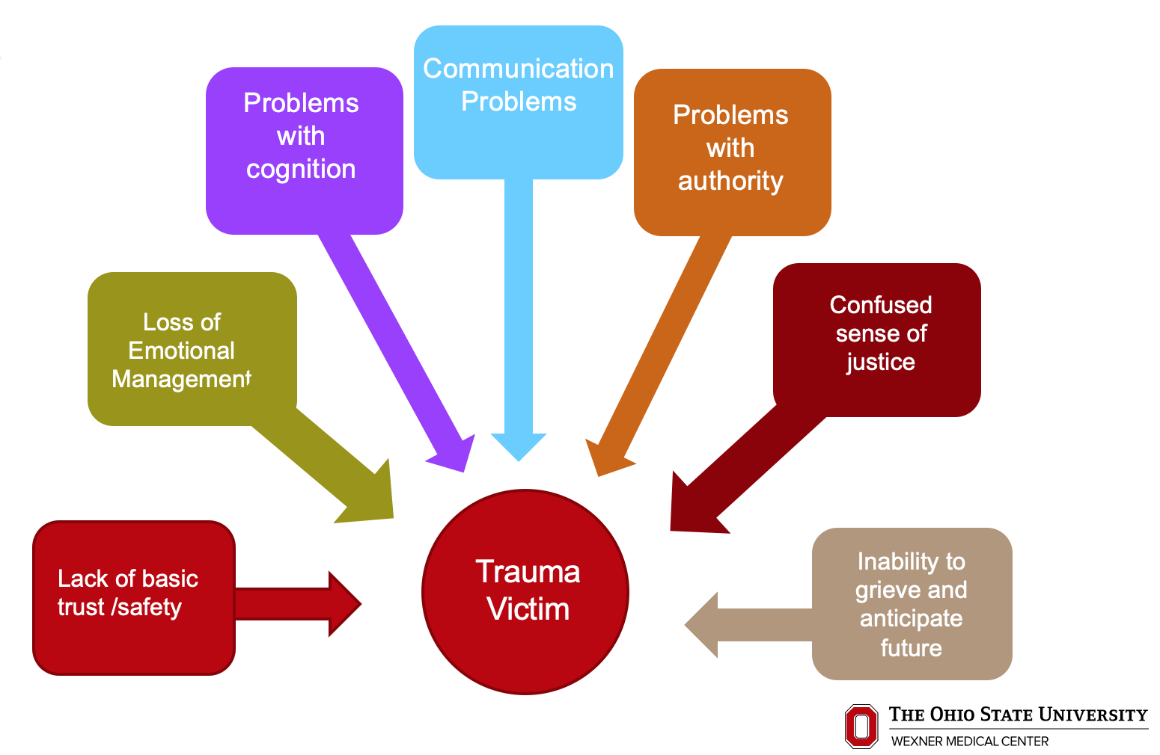
Trauma Organized Person
Notes:
Our brain reorganizes as a result of traumatic experiences.

Slide 23
Common Behavioral Indicators of Trauma
Splitting
Manipulation
Anger
Argumentative
Hypervigilant
Control
Avoidance
Trust
Intimacy
Passive Aggressive
Dependent
Acting out
Testing Boundaries

Slide 24
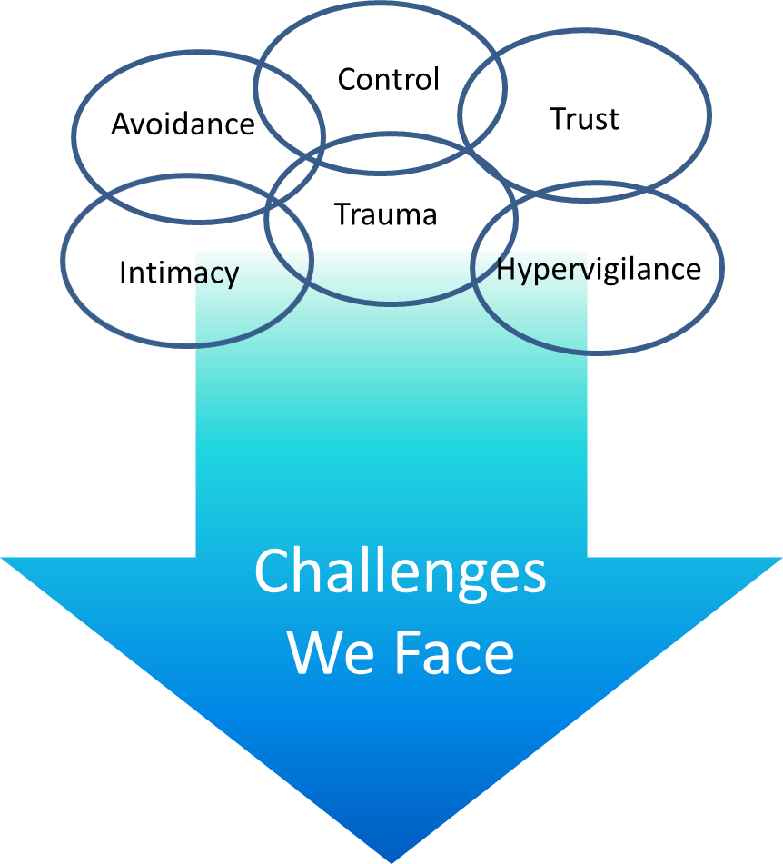

Slide 25
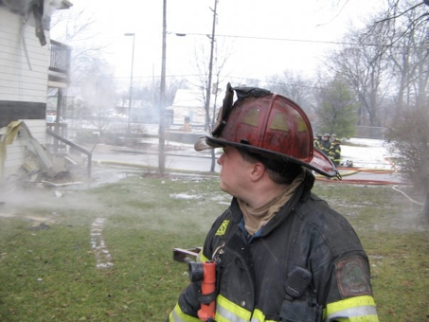
Notes:
Dave’s story

Slide 26
What can we do about it?
Collaborative Grid Approach

Slide 27
What can we do about it?
Individually:
Take care of ourselves on and off the job.
Acknowledge what we are experiencing
Tell someone we trust about what we are experiencing and get support
At the fire station:
Notice if someone doesn't’ seem to be themselves.
Let them know that you noticed and ask them how they are doing and if there is anything you can do for them or that they need to talk about
Support each other – even if someone doesn’t seem to want support find ways to support them.

Slide 28
What can we do about it?
As a fire department:
Acknowledge that members of the fire department may experience stress, burnout, trauma and secondary trauma
Provide a supportive environment where staff can share what’s happening and get the support that they need
Provide formal and informal opportunities to talk about shared experiences on the job.
Identify ways to meet the needs of members
Consider developing a chaplain program
Identify professional counselors/ social workers that can assist in more difficult situations.

Slide 29
Firefighter Mental Health- A systematic approach
Prevention
Psychological First Aid
Peer Support (formal and informal)
Crisis Incident Stress Management
Professional Mental Health Supports
Fire Department policies and procedures for member mental health care

Slide 30
Are you getting all of your needs met?
Prevention of a traumatic response:
SPICES of life!
Social
Physical
Intellectual
Creative
Emotional
Spiritual
Notes:
You can reduce your risk for experiencing trauma by making sure all of your needs are met.

Slide 31
Prevention of a traumatic response:
Take care of ourselves on and off the job:
Self-Awareness
Faith
Hope
Adaptability
Empathy
Acceptance
Flexibility
Vulnerability
Connection
Compassion
Self-care

Slide 32
Prevention of a traumatic response:

Slide 33
Psychological First Aid (PFA)
“Designed to reduce the initial distress caused by traumatic events and to foster short- and long-term adaptive functioning and coping. PFA does not assume that all survivors will develop severe mental health problems or long-term difficulties in recovery. Instead, it is based on an understanding that disaster survivors and others affected by such events will experience a broad range of early reactions (e.g., physical, psychological, behavioral, spiritual). Some of these reactions will cause enough distress to interfere with adaptive coping, and recovery may be helped by support from compassionate and caring disaster responders.”
https://www.nctsn.org/treatments-and-practices/psychological-first-aid-and-skills-for-psychological-recovery/about-pfa

Slide 34
Psychological First Aid
The eight PFA Core Actions include:
Contact and Engagement: To respond to contact or to initiate contacts in a non-intrusive, compassionate, and helpful manner.
Safety and Comfort: To enhance immediate and ongoing safety, and provide physical and emotional comfort.
Stabilize and/or provide support: To calm and orient emotionally overwhelmed or disoriented individuals
Information Gathering on Current Needs and Concerns: To identify immediate needs and concerns, gather additional information, and tailor next steps.
Practical Assistance: To offer practical help in addressing immediate needs and concerns.
Connection with Social Supports: To help establish brief or ongoing contacts with primary support persons and other sources of support, including family members, friends, co-workers and community helping resources.
Information on Coping: To provide information about stress reactions and coping to reduce distress and promote adaptive functioning.
Linkage with Collaborative Services: To link individuals with available services needed at the time or in the future.
https://www.nctsn.org/treatments-and-practices/psychological-first-aid-and-skills-for-psychological-recovery/about-pfa
Notes:
Case scenario and Role play?

Slide 35
Psychological First Aid
Contact and Engagement: To respond to contact or to initiate contacts in a non-intrusive, compassionate, and helpful manner.
A peer asks for help wants to talk.
You notice that a peer might need help or need to talk
You make yourself available to talk
https://www.nctsn.org/treatments-and-practices/psychological-first-aid-and-skills-for-psychological-recovery/about-pfa
Notes:
Case scenario and Role play?

Slide 36
Psychological First Aid
Safety and Comfort: To enhance immediate and ongoing safety, and provide physical and emotional comfort.
Offer to go for a walk or to sit down.
If the person seems cold offer a blanket or something warm to drink.
Make sure you are in a safe and confidential space to talk
https://www.nctsn.org/treatments-and-practices/psychological-first-aid-and-skills-for-psychological-recovery/about-pfa
Notes:
Case scenario and Role play?

Slide 37
Psychological First Aid
Stabilize and Provide support: To calm and orient emotionally overwhelmed or disoriented individuals.
Assess immediate needs
Reduce stimuli and stress
https://www.nctsn.org/treatments-and-practices/psychological-first-aid-and-skills-for-psychological-recovery/about-pfa
Notes:
Case scenario and Role play?

Slide 38
Psychological First Aid
Information Gathering on Current Needs and Concerns: To identify immediate needs and concerns, gather additional information, and tailor next steps.
Listen (level 2- expansive listening)
Validate feelings and needs
Help regulate breathing
Provide clear instructions
https://www.nctsn.org/treatments-and-practices/psychological-first-aid-and-skills-for-psychological-recovery/about-pfa
Notes:
Case scenario and Role play?

Slide 39
Psychological First Aid
Practical Assistance: To offer practical help in addressing immediate needs and concerns.
Ask what the person needs
Link to support resources
https://www.nctsn.org/treatments-and-practices/psychological-first-aid-and-skills-for-psychological-recovery/about-pfa
Notes:
Case scenario and Role play?

Slide 40
Psychological First Aid
Connection with Social Supports: To help establish brief or ongoing contacts with primary support persons and other sources of support, including family members, friends, co-workers and community helping resources.
If willing, have the individual connect with supportive family members, friends or co-workers
https://www.nctsn.org/treatments-and-practices/psychological-first-aid-and-skills-for-psychological-recovery/about-pfa
Notes:
Case scenario and Role play?

Slide 41
Psychological First Aid
Information on Coping: To provide information about stress reactions and coping to reduce distress and promote adaptive functioning.
Provide general information about stress, burnout, trauma and secondary trauma and it’s impact
Normalize the situation -
Describe normal reactions to abnormal events
Explain what’s to be expected next.
https://www.nctsn.org/treatments-and-practices/psychological-first-aid-and-skills-for-psychological-recovery/about-pfa
Notes:
Case scenario and Role play?

Slide 42
Psychological First Aid
Linkage with Collaborative Services: To link with available services needed at the time or in the future.
Develop a plan based on needs and resources
Identify easily implemented action steps.
Link with peers on the individuals shift
Check back to ensure all is well
Reassure the process is “normal”
https://www.nctsn.org/treatments-and-practices/psychological-first-aid-and-skills-for-psychological-recovery/about-pfa
Notes:
Case scenario and Role play?

Slide 43
Peer Support
Formally and informally firefighters support each other.
Firefighters need to support each other.
How might firefighters support each other to reduce the risk of the impact of trauma?
https://www.nctsn.org/treatments-and-practices/psychological-first-aid-and-skills-for-psychological-recovery/about-pfa

Slide 44
Peer Support
Peer Supporters learn the components of behavioral health and the commonality of behavioral health disorders. They serve as advocates for mental health and become a first line of defense for a firefighter who may be suffering in silence.
The three main components of peer support are:
Listening
Confidentiality
Action planning

Slide 45
Peer Support - DO
Notice individuals that may need to talk
Be available and non-judgmental
Listen - hear the story from their perspective
Summarize what you heard
Empathize with the individual
Limit potential distraction
Make eye contact or sit next to the person to show support
Notice differences in what the person says vs their behavior
Ask supportive questions – (what can I do? Who else would you like to talk to? What do you need right now? Etc)
Respect privacy of the individual

Slide 46
Peer Support – DON’T
Do not jump to conclusions
Do not tell the person how they feel is wrong
Do not judge
Do not move to solve the problem before understanding the entire story
Avoid closed questions
Do not offer your solutions – Instead, get their thoughts/ideas.
Do not tell other peers about the content of the conversation without permission (unless there is a safety concern).
Do not take calls or have other discussions during the support conversation

Slide 47
Peer Support – Trauma Informed Responses
Respect
Essential that we offer and expect respect
Respect is the key to regaining self-assurance and self-confidence
Self-assurance and self-confidence are key components to return to functioning.
Process an event in a neutral area. This offers both space and time needed to process what just happened.
-Take a walk
-Get coffee or tea together
-Discuss what’s needed
-Share experiences

Slide 48
Peer Support – Trauma Informed Responses
Safety
Responding to emergencies that have an emptional impact can lead individuals to begin to question their ability to continue to respond to emergencies safely.
Assure peers of their skills and abilities
Support peers in sitting out a run or taking a day off
Ensure that peers aren’t isolating themselves.
Reality check that reasonable persons within a reasonable system typically will make reasonable decisions.
Assure the peer that they are not in this alone.
Ask if they are thinking of hurting themselves or someone else and seek help accordingly.

Slide 49
Peer Support – Trauma Informed Responses
Allow Safe Space
One’s perception of “how close is close enough” depends on a number of factors:
How well the person knows you
The person’s current state of stress
The setting for offering space e.g., closed in, face to face, side by side.
History of trauma
Cultural factors
Do not approach from behind or without notice.

Slide 50
Peer Support – Trauma Informed Responses
Announce Intentions
Tell “what happens next”
Describe the process step-by-step
Theory of 3’s or 5’s
Reactions for 3-5 days, weeks, months and years
Communication
Keep calm, consider your facial expression and body language
Take it slow and easy, this isn’t a quick fix
Keep it conversational and normalize to the extent possible
Use clear simple phrasing to avoid confusion

Slide 51
Peer Support – Trauma Informed Responses
When safely possible…respond
Be sensitive to fear
When the outcome is unknown anything is possible
A threat to a person’s license is a threat to their livelihood
Stay grounded in the moment
Use patience
This will not be a quick fix
Expect “yes but…” responses
Don’t’ take it personally
Avoidance, control and trust are all expected responses
Statements like “how would you know” present an opportunity to share
Be flexible when considering options

Slide 52
Peer Support – Listening
Level 1: Internal Listening
We listen to our own inner voice and may hear the words of the other person but we are more aware of our story, judgment, feelings, needs or opinion. We may even be giving nonverbal cues we are ‘present’ but we are thinking things such as :
I am so bored; wonder if I have any emails? I am really hungry, where will I go for lunch? Why did I just say that? He probably thinks I am really stupid.

Slide 53
Peer Support – Listening
Level 2: Expansive Listening
This is when our listening is focused in one direction. Think about a parent with a sick child; all of their attention is on the child’s needs and on getting well. There might be a lot of chaos around them, but the focus remains on that child. When you are oblivious to the world around you, you are focused and listening intently to every word.

Slide 54
Peer Support – Listening
Level 3: Global Listening
This is the soft focus listening that takes in everything. At this level we are aware of the energy between ourselves and others. We are aware of when and how that energy changes. We can detect a shift in attitude, an unspoken reaction to something that was said or feelings such as sadness. We are aware of what is around us, how our words are being received and when our ideas are landing and when they are not. This is when intuition will be most available to us.

Slide 55
Peer Support – Listening
Reflections and Questions to ask:
“You see.......as a challenge that feels impossible to overcome”.
“I hear you saying.....is that right?”
“I’m noticing that you smiled as you said that and it looks like you are tearing up. What’s happening for you right now?”
“I wonder if you’d like to stay with that idea a little bit. I noticed you do not seem excited about that choice”.

Slide 56
Peer Support – Confidentiality
Peer supporters should maintain confidentiality regarding conversations with peers – unless there is a risk of suicidal or homicidal behavior or in the case of reported child abuse.
Some departments may identify other times peers must break confidentiality for the best interest of its members or the department.
Policies and Procedures should be written for responding when there is a risk or when confidentiality must be broken.

Slide 57
Peer Support – Action Planning
Individuals may need additional support this could include:
Another time to talk with the peer
Connecting with family or friends outside the fire department
Connecting with peers outside of work
Support on the job
Support to take time off
Professional individual or family therapy
Substance abuse treatment
Medication
Hospitalization or inpatient treatment

Slide 58
Peer Support – Action Planning
Peer Support programs need referral sources that peers trust as providers that understand the specific needs of firefighters and first responders and that can be available as a resource for the peers to provide referrals.

Slide 59
Peer Support –
Characteristics of a peer supporter -
Prefer three to five years of on the job experience.
Demonstrated track record of compassionate yet, non-reactionary response to stressors.
Demonstrated value in self-care.
Awareness of importance of discrete conversation in supporting others.
Identified as a trusted team member.
Identified as a respected peer leader.
Maintains a strong common sense base.

Slide 60
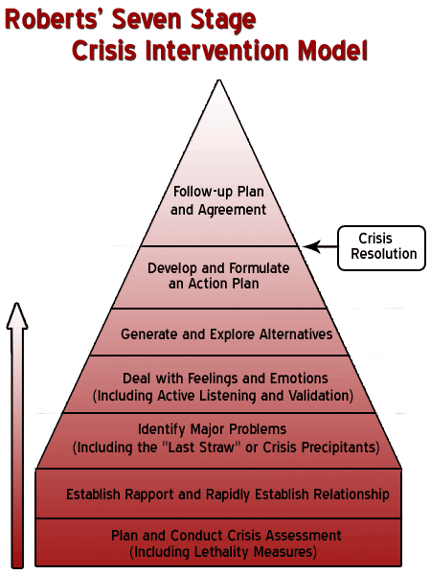

Slide 61
Crisis Intervention
Complete assessment of immediate need:
Assess for safety
Assess ability to function in work environment
Immediate needs

Slide 62
Crisis Intervention
Establish Rapport:
Introduce yourself and your role if the individual does not know you
Tell individual about peers support
Listen

Slide 63
Crisis Intervention
Identify Major Problems:
What was the last straw?
What requires immediate attention?
What are the major concerns you have about the situation?
What are the major concerns others have about the situation?

Slide 64
Crisis Intervention
Deal with feelings and emotions:
Expansive listening
Validation
Clarification and summarizing

Slide 65
Crisis Intervention
Generate and explore alternatives:
What has worked in the past to deal with stress?
What is the best thing for the individual to do next?
Who would the individual like to touch base with next about what’s happening/what happened?
Who can support them at work?

Slide 66
Crisis Intervention
Develop and formulate an action plan:
Identify immediate next steps
Confirm that the actions will be helpful
Ask what resources are needed
Link to appropriate support

Slide 67
Crisis Intervention
Follow up plan/agreement
Develop a follow up plan with the individual
Recommend 3 follow-ups
First Follow up: “We are here for you”
Second Follow up: “We care about you and your work”
Third Follow up: “We want to be certain things are back to “normal.” You are our most important resource!
Let the individual know that you are available, as needed, for follow up and support.

Slide 68
Crisis Intervention
First Follow up: “We are here for you”
How have you been doing?
Have you experienced any difficulties?
How has your sleep been?
Any intrusive thoughts?
Any immediate fears/concerns?
How is your appetite?
Listen, clarify, support
Reframe any negative thoughts

Slide 69
Crisis Intervention
Second Follow up: “We care about you and your work”
How have you been doing?
Have things begun to return to normal?
How has the process been for you?
Do you have any questions?
Are there any resources you need?

Slide 70
Crisis Intervention
Third Follow up: “We want to be certain things are back to “normal.” You are our most important resource!
Are there any remaining issues?
Do you feel supported?
Have you reintegrated fully into the daily work process?
Let the individual know that you are available, as needed, for follow up and support.

Slide 71
Critical Incident Stress Management
Benefits of a CISM Intervention:
Reduces stress experienced at work and home.
Reduces feelings of isolation and abnormality.
Prevents onset of delayed psychological reactions.
Improves coping skills for future incidents.
Reduces effects of stress-related diseases.
Reduces early retirement due to job related stressor, accidents, injuries and/or disease.
Enhances job satisfaction.
Supports professionals and their families in time of need.
Provides educational and psychological support for job related stress.
Promotes educational and psychological support for job related
stress.

Slide 72
Critical Incident Stress Management
Formal Debriefing
Psalm 18:6-35
6In my distress I called to the Lord; I cried to my God for help. From His temple He heard my voice; my cry came before Him, into His ears... 16He reached down from on high and took hold of me; He drew me out of deep waters... 32It is God who arms me with strength and keeps my way secure... 35You make Your saving help my shield, and Your right hand sustains me; Your help has made me great.

Slide 73
Critical Incident Stress Management
Formal Debriefing Goals
Reducing the impact of the traumatic events
Facilitates Recovery
Helps to identify if additional supports are needed.

Slide 74
Critical Incident Stress Management
Formal Debriefing - preparation
Needs to occur with the firefighters & officers that were involved in the incident
Needs to occur soon after the incident has occurred
Should not occur if the incident if still happening or is ongoing
Group members (3-20 people) should have had about the same level of experience in the incident

Slide 75
Critical Incident Stress Management
Critical Incident Stress Debriefing
Timing
- 24 to 72 hours after an event
- Allows for some processing & decompressing before the formal review.
- Allows for psychological readiness

Slide 76
Critical Incident Stress Management
Critical Incident Stress Debriefing - Phases
Introduction - introductions, describe the process, create ground rules, encourage active engagement in the process (although involvement in the discussion is voluntary)
Facts
Thoughts
Reactions
Symptoms
Teaching
Re-Entry

Slide 77
Critical Incident Stress Management
Critical Incident Stress Debriefing - Phases
Introduction
Facts - Extremely brief review of the facts, excessive detail is DISCOURAGED, this helps to get participants talking, assists in reducing anxiety. Ask the question, can you give our team a brief overview of what happened from your view point. (give everyone an opportunity to speak)
Thoughts
Reactions
Symptoms
Teaching
Re-Entry

Slide 78
Critical Incident Stress Management
Critical Incident Stress Debriefing - Phases
Introduction
Facts
Thoughts - Move from cognitive to affective domain. “What was your first thought about the situation?” (give everyone an opportunity to speak)
Reactions
Symptoms
Teaching
Re-Entry

Slide 79
Critical Incident Stress Management
Critical Incident Stress Debriefing - Phases
Introduction
Facts
Thoughts
Reactions - This is the heart of CISD. Focuses on the impact of the event on the participants. Anger, frustration, sadness, loss, confusion, and other emotions may emerge. The trigger question is “What is the worst thing about the event for you personally?” Listen carefully, encourages discussion. (give everyone an opportunity to speak)
Symptoms
Teaching
Re-Entry

Slide 80
Critical Incident Stress Management
Critical Incident Stress Debriefing - Phases
Introduction
Facts
Thoughts
Reactions
Symptoms - Ask, “How has this tragic experience shown up in your life?” or What cognitive, physical, emotional or behavioral symptoms have you been dealing with since this event? Listen for common symptoms/ responses
Teaching
Re-Entry

Slide 81
Critical Incident Stress Management
Critical Incident Stress Debriefing - Phases
Introduction
Facts
Thoughts
Reactions
Symptoms
Teaching - Normalize the symptoms brought up by the participants. Provide explanations of the participants’ reactions & provide stress management information. Other topics may be discussed as relevant
Re-Entry

Slide 82
Critical Incident Stress Management
Critical Incident Stress Debriefing - Phases
Introduction
Facts
Thoughts
Reactions
Symptoms
Teaching
Re-Entry - Participants ask follow up questions, provide next steps, affirm plans for next step for additional supports or to return to work.

Slide 83
Critical Incident Stress Management
Critical Incident Stress Debriefing - Phases
Introduction
Facts
Thoughts
Reactions
Symptoms
Teaching
Re-Entry

Slide 84
Critical Incident Stress Management
Critical Incident Stress Debriefing - Follow-up
Talk with individuals to identify next steps.
Use peer support follow up plan

Slide 86
How does a Trauma Informed System work?
Realizes
Realizes widespread impact of trauma and understands potential paths for recovery
Recognizes
Recognizes signs and symptoms of trauma in children, families, staff, and others involved with the system
Responds
Responds by fully integrating knowledge about trauma into policies, procedures, and practices
Resists
Seeks to actively Resist re-traumatization.
Yeager, K., Cutler, D. L., Svendsen, D., & Sills, G. M. (2013). Modern community mental health: An interdisciplinary approach. Oxford University Press

Slide 87
Firefighter Mental Health- A systematic approach
Prevention – encourage self care, positive work environment, talking about home and work life
Psychological First Aid – provide training for first responders on psychological first aid and encourage peers to use PFA with each other
Peer Support (formal and informal) – train peers in peer support internventions and create a formal peer support team that is identified in the department to support its members.
Crisis Incident Stress Management - train department members to provide CISM and debriefings in the context of peer support and follow up.
Professional Supports – identify providers in your community for outpatient treatment, inpatient treatment, individual and family therapy. Educate providers about the unique needs of first responders.
Fire Department policies and procedures for member mental health care – develop policies and procedures to guide your system of care to ensure best practices for members.

Slide 88
Resources:
www.everyonegoeshome.org
www.info-trauma.org
Psychological First Aid Training -
learn.nctsn.org
Critical Incident Stress Management training
Mindfulness
The Ohio State University- Wexner Medical Center STAR training
2 Thessalonians 3:3
But the Lord is faithful, and He will strengthen you
and protect you from the evil one.

Slide 89
www.AfricaFireMission.org

