Slide 1

FireFighter
CanCer Prevention
Taking Action Against Occupational Cancer In The Fire Service
Materials revised from: HaRPER College Fire Science Program

Slide 2
Learning Objectives
Define what cancer is and how it affects our society.
Recognize the scope of the cancer problem in the Fire Service over the past several decades.
Examine the culture of the Fire Service regarding the use of PPE and SCBA.
Discuss the increase in toxic agents in today’s fire environment and how that affects Firefighters.
Identify routes of exposure to cancer-causing agents.
Discuss common Firefighter exposures to carcinogens.
Review the steps Firefighters can take to protect themselves from cancer.
Challenge Firefighters to change their culture.

Slide 3
What is Cancer?
Cancer: Is an abnormal growth of cells which tend to proliferate in an uncontrolled way and, in some cases, to metastasize (spread).
Cancer is a group of more than 100 different and distinctive diseases.
Cancer can involve any tissue of the body and have many different forms in each body area. Most cancers are named for the type of cell or organ in which they start.
Cancer may occur anywhere in the body. In women, breast cancer is one of the most common. In men, it’s prostate cancer. Lung cancer and colorectal cancer affect both men and women in high numbers.

Slide 4
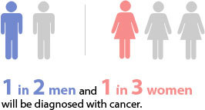
Affects of Cancer
According to U.S. Cancer Statistics - in 2016, an estimated 1,685,210 new cases of cancer Were diagnosed in the United States and 595,690 people Died from the disease.
The most common cancers: breast cancer, lung and bronchus cancer, prostate cancer, colon and rectum cancer, bladder cancer, melanoma of the skin, non-Hodgkin lymphoma, thyroid cancer, kidney and renal pelvis cancer, leukemia, endometrial cancer, and pancreatic cancer.

Slide 5
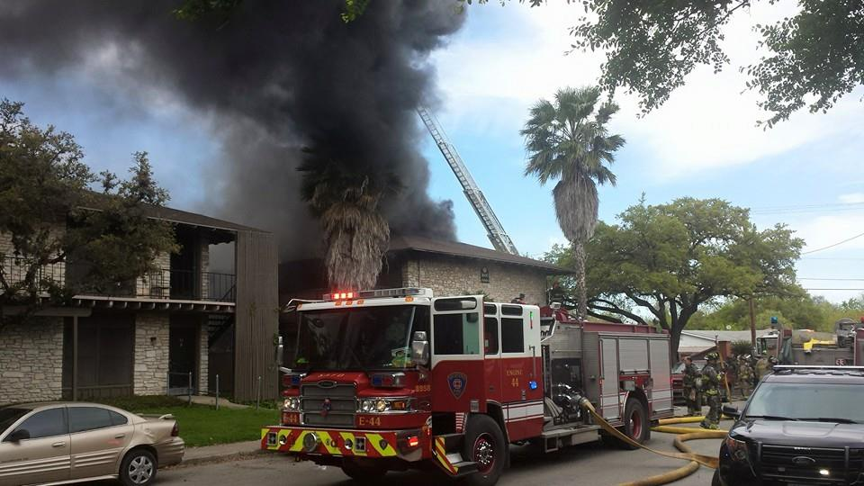
Scope Of The Cancer Problem In The Fire Service
  Cancer is one of the most dangerous threats to the health and safety of firefighters everywhere.
  Multiple studies have proven the link between firefighting and cancer

Slide 6
Scope Of The Cancer Problem In The Fire Service
“Pinpointing the exact cause of cancer is extremely difficult because firefighters are not exposed to just one agent. They are exposed to multiple cancer-causing agents. Because of the multiple exposures and the multiple routes of exposure – they inhale carcinogens and carcinogens are absorbed through the skin – it is also highly unlikely for firefighters to get only one type of cancer.”
- Dr. Grace Le Masters, PhD, Department of Environmental Health at the University of Cincinnati -

Slide 7
Scope Of The Cancer Problem In The Fire Service
Studies have shown higher rates of multiple types of cancers in firefighters compared to the general population including:
  Testicular cancer (2.02 times greater risk)
  Multiple myeloma (1.53 times greater risk)
  Non-Hodgkin’s lymphoma (1.51 times greater risk)
  Skin cancer (1.39 times greater risk)
  Brain cancer (1.32 times greater risk)
  Malignant melanoma (1.31 times greater risk)
  Prostate cancer (1.28 times greater risk)
  Colon cancer (1.21 times greater risk)
  Leukemia (1.14 times greater risk)
  Breast cancer in women (preliminary study results from the San Francisco Fire Department)
- Cancer Risk Among Firefighters: A Review and Meta-Analysis of 32 Studies; “Taking Action Against Cancer in the Fire Service” white paper – Firefighter Cancer Support Network -

Slide 8
Scope Of The Cancer Problem In The Fire Service
“Some cancer studies are also noting that firefighters are developing far more aggressive types of cancers, such as brain cancers, at a younger age than the general population, which provides further indications that the cancer could be a result of firefighting.”
- “Taking Action Against Cancer in the Fire Service” white paper – Firefighter Cancer Support Network -

Slide 9
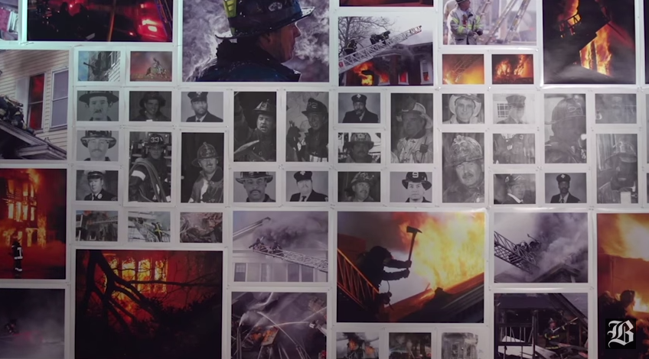
Scope Of The Cancer Problem In The Fire Service
Boston Fire Department Cancer Video

Slide 10
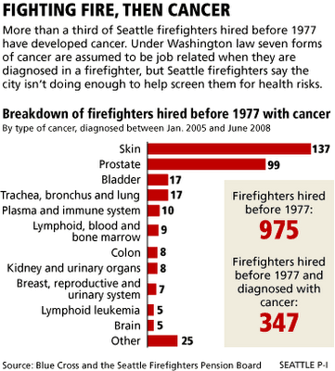
36% of the 975 firefighters diagnosed with cancer

Slide 11
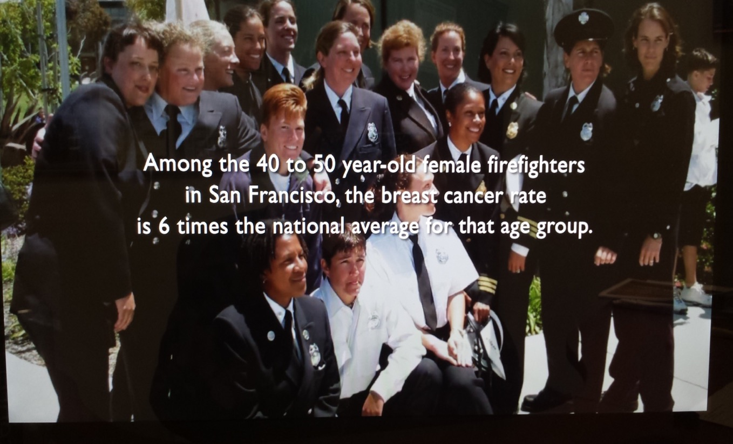
- HBO Documentary Film “Toxic Hot Seat” -

Slide 12
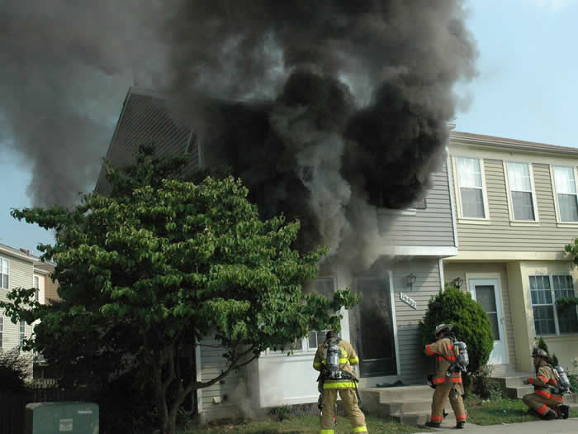
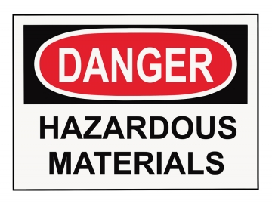
Toxicity
  Contents made primarily of plastic and synthetic materials.
  Approximately 84,000 chemicals being used commercially today.
  Flame retardants in furniture.
- “Taking Action Against Cancer in the Fire Service” white paper – Firefighter Cancer Support Network; HBO Documentary film “Toxic Hot Seat” -

Slide 13
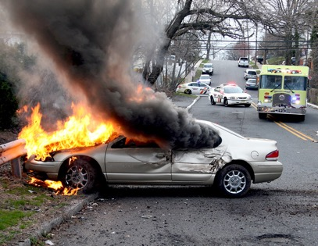
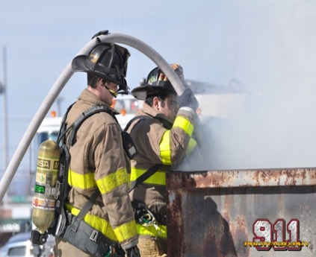
Toxicity
Vehicle fires release highly concentrated toxic chemicals.
Dumpster fires contain unknown materials and toxic substances.
- “Taking Action Against Cancer in the Fire Service” white paper – Firefighter Cancer Support Network -

Slide 14
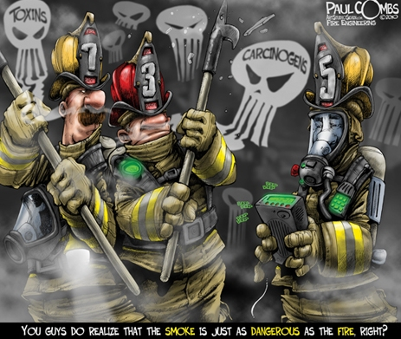
Routes of Exposure
Two routes of greatest concern for exposure to carcinogens:
  The Lungs: Occurs when firefighters do not wear or remove their SCBA too soon.
  Dermal Absorption: Carcinogens are absorbed through the firefighter’s skin.
- “Taking Action Against Cancer in the Fire Service” white paper – Firefighter Cancer Support Network -

Slide 15
Routes of Exposure
Skin can easily absorb chemicals – some areas are more permeable than others:
  Face, angle of the jaw, neck, throat and groin.
  Permeability increases with temperature.
    Skin absorption increases by 400% for every 5°increase in skin temperature.
- “Taking Action Against Cancer in the Fire Service” white paper – Firefighter Cancer Support Network -

Slide 16
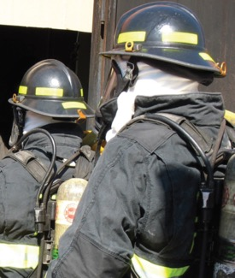
Routes of Exposure
Most permeable piece of PPE is the hood.
  Designed to protect the head and neck from heat.
  Not designed to stop skin absorption through the forehead, angle of the jaw, the neck, and throat.
    Offers no vapor/moisture or smoke protection.
  Liquid integrity test.
- “Taking Action Against Cancer in the Fire Service” white paper – Firefighter Cancer Support Network; Jeffrey O. and Grace G. Stull – International Personal Protection Inc.; Evaluation of Dermal Exposure to Polycyclic Aromatic Hydrocarbons in Fire Fighters -

Slide 17
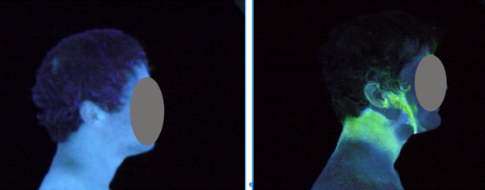
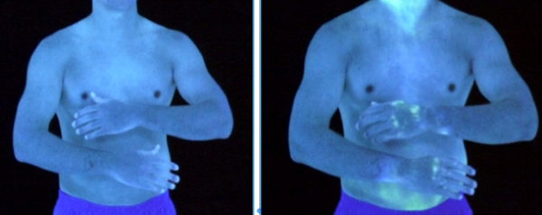
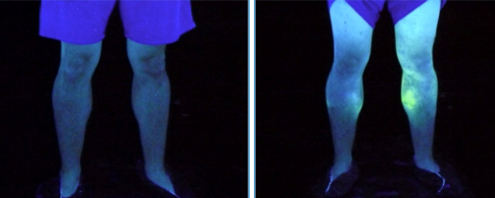
Routes of Exposure
          IAFF/RTI International Particle Infiltration Study - Video

Slide 18
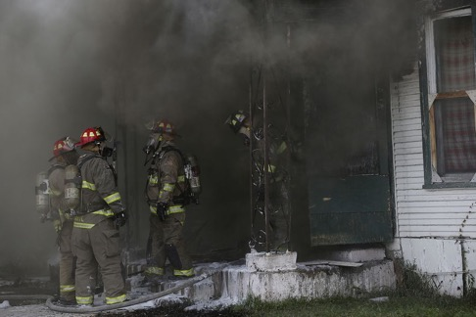
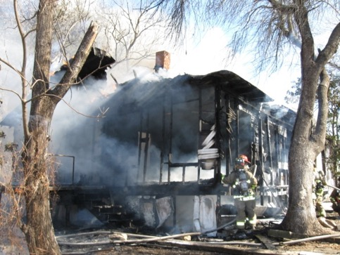
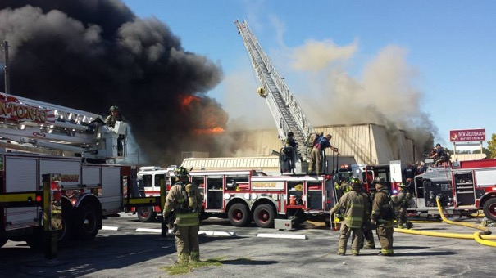
Common Firefighter Exposures to Carcinogens
During the overhaul process
Soot particles
Diesel engine exhaust
- IAFF’s Working to Death: Leading Causes of Death Among First Responders – Fighting Fires. Fighting Cancer -

Slide 19
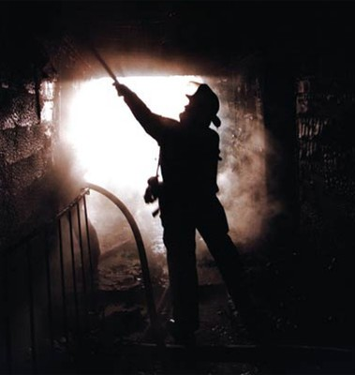
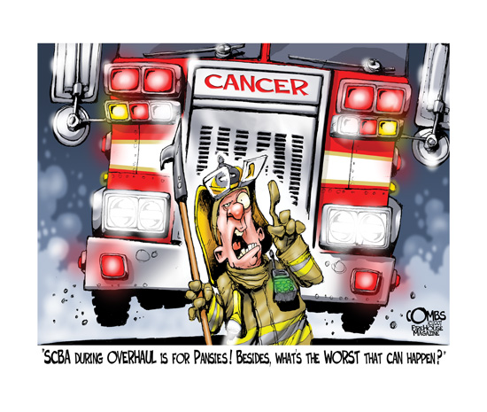
Characterization of Firefighter Exposures During Fire Overhaul
Today's synthetic and plastic household items present a risk to firefighters even after the fire is out.
  Smoldering materials release chemicals that firefighters continue to breathe.

Slide 20
Characterization of Firefighter Exposures During Fire Overhaul
  “Carbon monoxide should not be used as an indicator gas for other contaminants found in the overhaul atmosphere.”
- Characterization of Firefighter Exposures During Fire Overhaul Study – City of Phoenix -

Slide 21
Characterization of Firefighter Exposures During Fire Overhaul
SAFD Cancer Prevention SOP – “Summary of Required Actions” Section 02 – L:
  Full bunker gear and SCBAs shall be worn through overhaul operations when products of combustion and/or gases and vapors are present.

Slide 22
Soot Particles
First reported form of occupational cancer attributed to exposure to soot.
Prolonged exposure to soot on the skin is a hazard.
Soot particles absorb hazardous vapors and hold them in place on surfaces including a firefighter’s clothing and skin.
- Jeffrey O. and Grace G. Stull – International Personal Protection Inc.; IAFC; IARC -

Slide 23
Soot Particles
“A major cause of cancer in firefighters is Polycyclic Aromatic Hydrocarbons absorbed through the skin as a result of contact with soot, persistently and under hot conditions. The especially high permeability of the groin area results in increased testicular cancer and possibly other types of cancer.”
- Dr. Stuart Baxter, PhD, Professor of Environmental Health at the University of Cincinnati -

Slide 24
Soot Particles
“People think soot is benign but it is not, and most firefighters coming back from a fire are covered in soot. Soot isn’t just dirty, it’s dangerous”
“Soot in a firefighters’ hair or on their skin could leach chemicals into their bodies. Every smear on their clothes could release toxic gases long after the fire is out.”
-
Dr. Grace Le Masters, PhD, Department of Environmental Health at the University of Cincinnati -

Slide 25
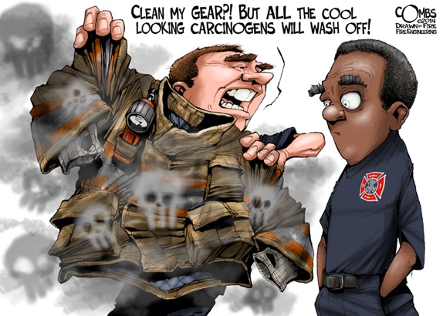
Soot Particles
If not removed, contaminated exterior surfaces and inner layers of a firefighter’s PPE can result in exposure well after the fire.
Neck area is one of the most likely areas to become contaminated.
Children being exposed to soot particles on our gear.
  At home
  Demos
- Jeffrey O. and Grace G. Stull – International Personal Protection Inc.-

Slide 26
Soot Particles
SAFD Cancer Prevention SOP – “Summary of Required Actions” Section .03 – B:
  Wet Decon – Immediate wet decon is essential to reducing contaminates that may have settled on your bunker gear (ex: asbestos). Therefore, wet decon is required anytime your gear may have been exposed to products of combustion or other contaminates, or if the Company Officer, Battalion Chief or Incident Commander deems it necessary. Every effort should be made to wet decon as soon as possible, preferably while still on scene. Use a red-line, at pump pressure, with a half opened nozzle. Rinse at a downward angle from top to bottom.

Slide 27
Actions to Protect YOURSELF From Cancer
Use breathing apparatus from initial attack to finish of overhaul.
Decontaminate protective equipment on emergency scene to remove as much smoke particles as possible.
Use sanitary wipes to remove to smoke particles from head, neck , jaw, throat, underarms and hands while still at emergency scene.
Wash your clothes immediately after a fire
Shower or clean your body thoroughly after a fire

Slide 28
Actions to Protect YOURSELF From Cancer
Clean your protective equipment, gloves, hood and helmet after a fire
Clean apparatus interior after a fire
Do not take contaminated clothes or protective equipment to your home
Do not take protective clothing into living or sleeping quarters
Do not use tobacco products
Use sunscreen

Slide 29
Firefighter Challenge
We are all responsible for our own safety.
If you don’t take care of yourself who do you expect to take care of you?
Safety has to be our #1 Priority.
More Firefighters are dying each and every year from Cancer, far more than any other category. LODD doesn’t tell the whole story!
We must change our culture and not accept Firefighters NOT using their PPE & SCBA.
It takes all of us to make this happen.
Start today and start “Saving Our Own!”

Slide 30
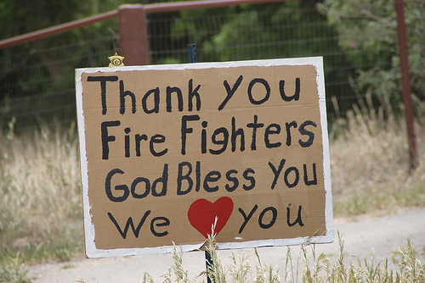
Stay Safe!

Slide 31
References
Taking Action Against Cancer in the Fire Service white paper
SAFD Cancer Prevention SOP
The Toxic Hot Seat, HBO
http://monographs.iarc.fr/ENG/Classification/
http://www.firerescue1.com/fire-products/Personal-protective-equipment-ppe/articles/1658839-8-ways-to-protect-against-cancer-with-PPE/
http://www.modernfirefighter.com/cancer-the-unseen-firefighter-killer/
http://www.breastcancer.org/symptoms/understand_bc/risk/understanding
Diesel Emissions in Fire Stations; Greg Michalak
A Study on Chemicals Found in the Overhaul Phase of Structure Fires Using Advanced Portable Air Monitoring available for Chemical Speciation; Regional Hazardous Materials Team HM09-Tualatin Valley Fire & Rescue Office of State Fire Marshal
Mortality and Cancer Incidence in a Pooled-Cohort of US Firefighters from San Francisco, Chicago, and Philadelphia (1950-2009); Daniels RD, Kubale TL, Yiin JH, et al. Occup Environ Med 2013;0:1–10. doi:10.1136/oemed-2013-101662.
Exposure–response relationships for select cancer and non-cancer health outcomes in a cohort of US firefighters from San Francisco, Chicago and Philadelphia (1950–2009); Daniels RD, Bertke S, Dahm MM, et al. Occup Environ Med 2015;0:1–8. doi:10.1136/oemed-2014-102671.
Fluorescent Aerosol Screening Test (FAST) Test Report – RTI International; Prepared by Jay Hill and prepared for Jeffrey O. Stull.

Slide 32
References
http://monographs.iarc.fr/ENG/Monographs/vol98/mono98-7.pdf
http://www.huffingtonpost.com/marcia-g-yerman/toxic-hot-seat-ignitesaw_b_4338572.html
Evaluation of Chemical and Particle Exposures During Vehicle Fire Suppression Training; NIOSH
Evaluation of Dermal Exposure to Polycyclic Aromatic Hydrocarbons in Firefighters; USDHHS, CDC, NIOSH
Exposure of Firefighters to Diesel Emissions in Fire Stations; Southern Occupational Health Center and Division of Environmental and Occupational Health Sciences.
Cancer Incidence Among Firefighters: 45 years of follow-up in five Nordic Countries; Pukkala E, Martinsen JI, Weiderpass E.
Characterization of Firefighter Exposures During Fire Overhaul; Boldstad-Johnson, Dawn M., Burgess; Jefferey L., Crutchfield; Clifton D., Storment; Steve, Gerkin, Richard; Wilson, Jeffrey R.
Cancer Risk Among Firefighters: A Review and Meta-analysis of 32 Studies; Grace K. LeMasters, PhD; Ash M. Genaidy, PhD; Paul Succop, PhD; James Deddens, PhD; Tarek Sobeih, MD, PhD; Heriberto Barriera-Viruet, PhD; Kari Dunning, PhD; James Lockey, MD, MS.
http://www.cancer.org/cancer/cancerbasics/lifetime-probability-of-developing-or-dying-from-cancer
https://www.fsi.illinois.edu/newsDetail.cfm?news_id=172
American Cancer Society
http://www.fireengineering.com/articles/2010/08/extinguishing-ff-cancer.html

Slide 33
References
https://www.osha.gov/SLTC/dieselexhaust/chemical.html
http://www.911healthwatch.org/cancer/
http://www.iafc.org/Operations/LegacyArticleDetail.cfm?ItemNumber=3356
http://monographs.iarc.fr/ENG/Monographs/vol100F/mono100F-21.pdf
https://eh.uc.edu/assets/news/11-27-2010-Lemasters.pdf
https://en.wikipedia.org/wiki/Chimney_sweeps%27_carcinoma
Systemic Exposure to PAHs and Benzene in Firefighters Suppressing Controlled Structure Fires; Kenneth W. Fent, Judith Eisenberg, John Snawder, Deborah Sammons, Joachim D. Pleil, Matthew A. Stiegel, Charles Mueller, Gavin P. Horn, James Dalto.
http://www.iarc.fr/en/media-centre/pr/2007/pr180.html
http://www.firerescue1.com/fire-products/hoods/articles/1677809-How-to-improve-the-next-gen-firefighter-hood/
Paul Combs, illustrations
http://www.firerescue1.com/fire-products/Personal-protective-equipment-ppe/articles/2154096-Firefighter-research-shows-PPE-exposure-risk/
http://www.firefightercancersupport.org/wp-content/uploads/2013/06/fighting_fires_fighting_cancer.pdf
http://www.iarc.fr/en/media-centre/pr/2012/pdfs/pr213_E.pdf
http://www.fasny.com/cancer-fire-service/
http://www.sfexaminer.com/sanfrancisco/breast-cancer-rate-alarms-sffd-female-firefighters/Content?oid=2317524

