Slide 1
Vehicle Stabilization
Joe Elliot
Joe Hansen
Craig Duck

Slide 2
Stabilization
How does your agency handle vehicle stabilization?
Notes:
2

Slide 3
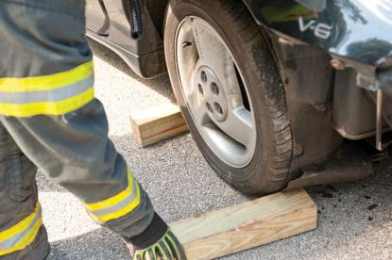
Cribbing
Used to stabilize a vehicle
Lengths of wood used to prevent a vehicle from moving backward and forward.
Notes:
3

Slide 4
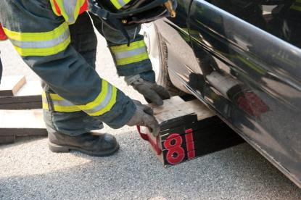
Step Chocks
Placed under the side of the vehicle
One toward front of vehicle
One toward rear of vehicle
Notes:
4

Slide 5
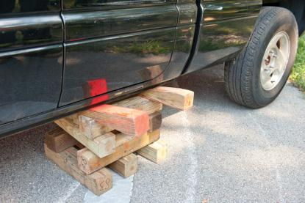
Box Crib
Standard cribbing can be used to form a box crib.
Place cribbing at right angles to the preceding layer of cribbing.
Notes:
5

Slide 6
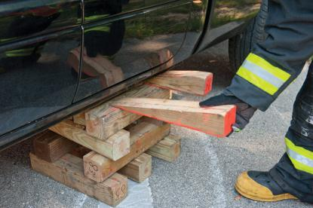
Wedges
Used to snug up loose cribbing or when using lift airbags
Should be the same width as the cribbing
Notes:
6

Slide 7
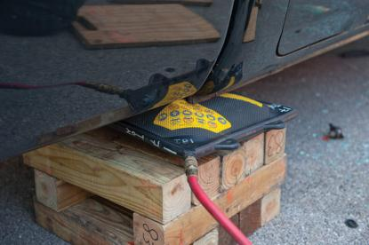
Rescue Lift Air Bags
Used to lift a vehicle or object off a victim
Always use cribbing when using rescue lift air bags.
Notes:
7

Slide 8
Low-Pressure Lift Air Bags
Often used in recovery operations
Sometimes used for vehicle rescue operations
Come in many shapes and sizes
Can be less stable until fully inflated
Notes:
8

Slide 9
Medium-Pressure Lift Air Bags
Have either two or three cells inside their design
Best when used in aircraft or truck rescue
Notes:
9

Slide 10
High-Pressure Lift Air Bags
Most common air bags used by the fire service for rescue work
Heavily constructed
Generally made of vulcanized rubber mats reinforced by steel
Notes:
10

Slide 11
www.AfricaFireMission.org

Slide 12
Materials utilized include:
Vehicle Stabilization
Copyright 2014 Jones & Bartlett Learning LLC and NFPA
Notes:
12

