Slide 1
Community Fire Safety & Prevention
Nancy Moore
Craig Duck
Donovan Weber

Slide 2
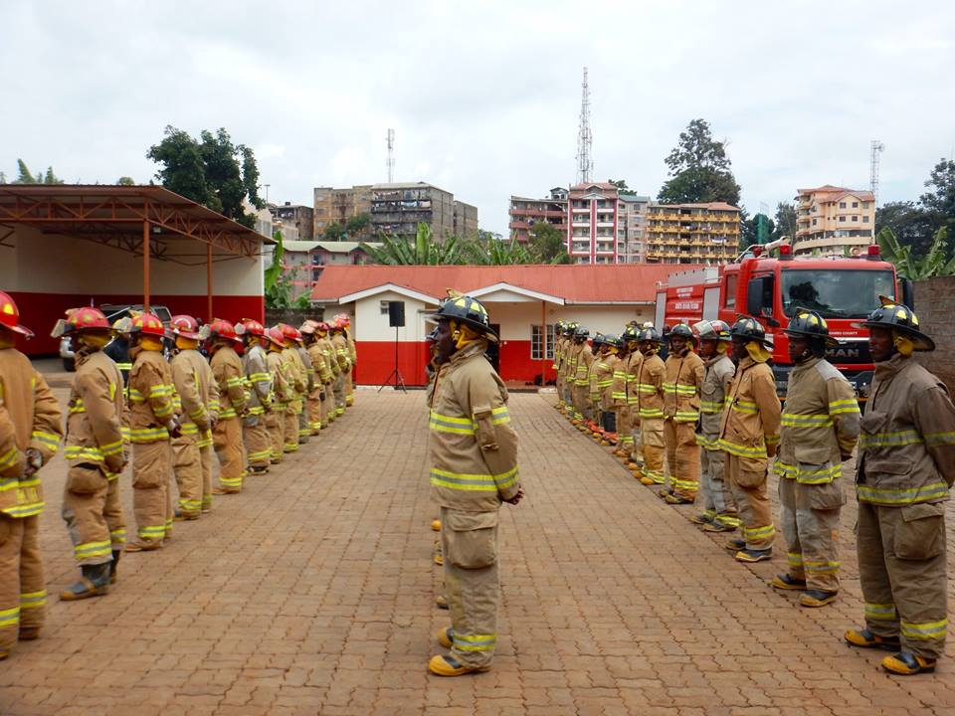
Mission:
Africa Fire Mission is a 501(c)(3) committed to increasing the sustainable capacity of fire departments across Africa. We accomplish this through training, empowerment, support and encouragement
Train
Empower
Support
Encourage
Core Values:
+ Partnership + Community Ownership + Development
+ Transformation + Sustainability + Advocacy + Innovation

Slide 4
Introductions – AFM Team
Nancy Moore
Craig Duck
Joe Elliott
Joe Hansen
Donovan Weber
Adam WoLF

Slide 5
Introductions
Name
Rank
What has been your experience with Community Fire Safety and Prevention?
Is there any specific Technique or Skill that you would like to learn or practice today?

Slide 6
Objectives
Review Current Community Fire Safety and Prevention Programs
Identify opportunities to Expand Community Fire Safety and Prevention programs
Review Community Health Education (CHE) teaching method.
Review Lessons and Opportunities available from AFM
Learn examples of the impact of Fire Safety and Prevention Programs in US and Kenya.

Slide 7
What are examples of Community Fire Safety and Prevention Program s in Your Community?

Slide 8
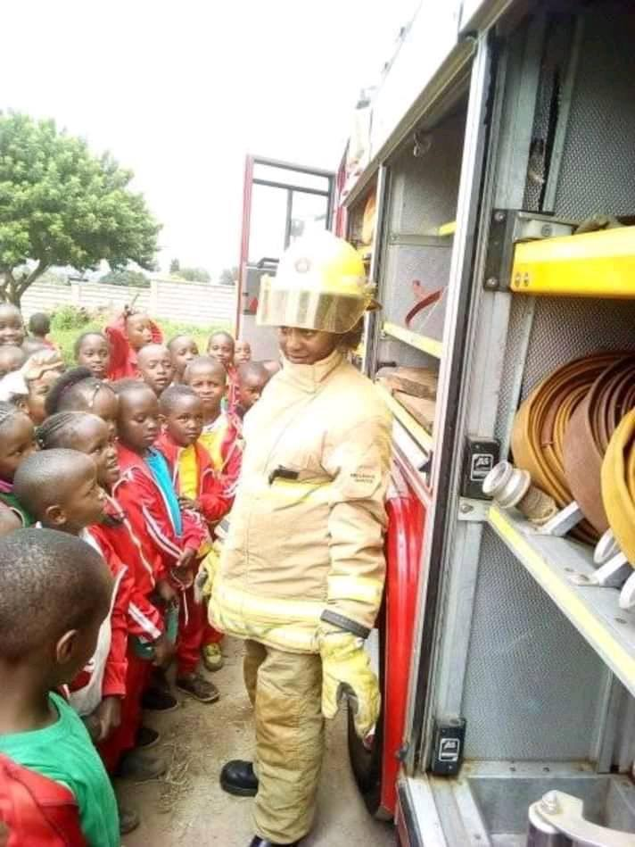
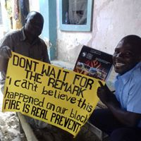
How do you educate Children? How Do you Educate Adults?
Notes:
Small groups?

Slide 9
Lessons Available from AFM
Understand the dangers of fire and safe response when fires occur.
prevent dangerous fires from
Candles/lamps
Cooking
Electrical fires
Be able to respond safely when there is a dangerous fire:
Stop Drop and Roll (putting out clothes on fire)
Fire Evacuations Drills – Sound the Alarm, Get Low and Get Out
Contacting the Fire Brigade
Use of fire extinguishers, SMOKE DETECTORS and other available safety equipment
Prevent and Respond –
Fires In Our Homes
Wild Fires

Slide 10
What Opportunities might exist to expand Current Fire Safety and Prevention Programs?

Slide 11
What Opportunities might exist to expand Existing Programs?
In Neighborhoods
In Schools
In Community Centers
In Businesses
In Hospitals or Nursing Homes
Other places

Slide 12
Programs Available from AFM
CHE Lessons for Adults
CHE Lessons for Children
CHE Programs FOR Schools
All Lessons and Programs can be adapted to meet the needs of your community.

Slide 13
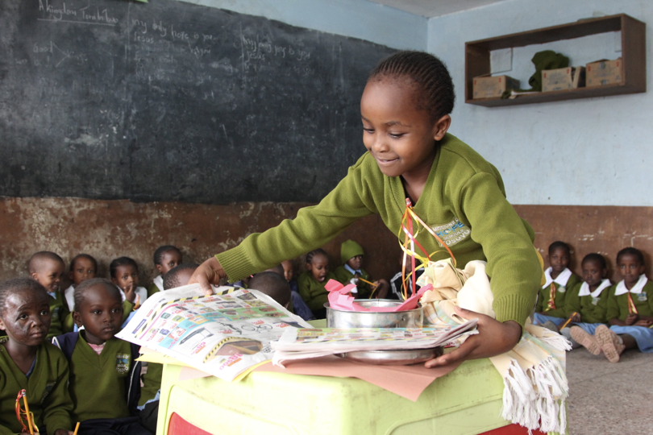
Notes:
Role Play/Stories

Slide 14
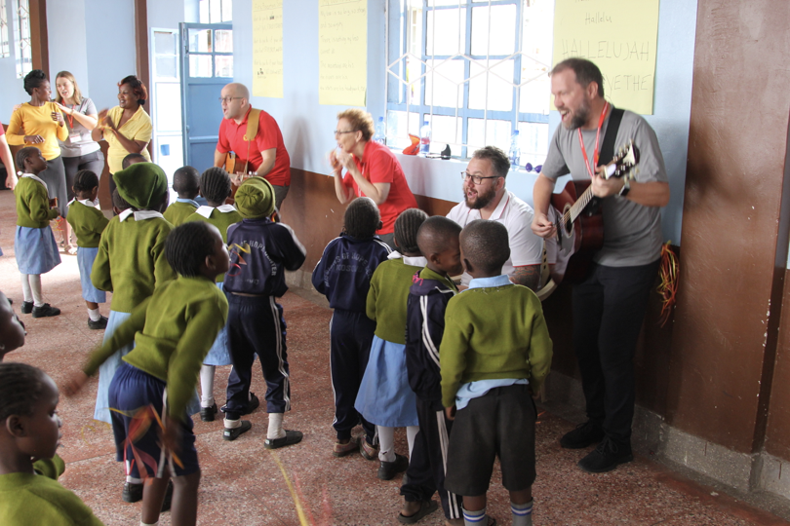
Notes:
Music

Slide 15
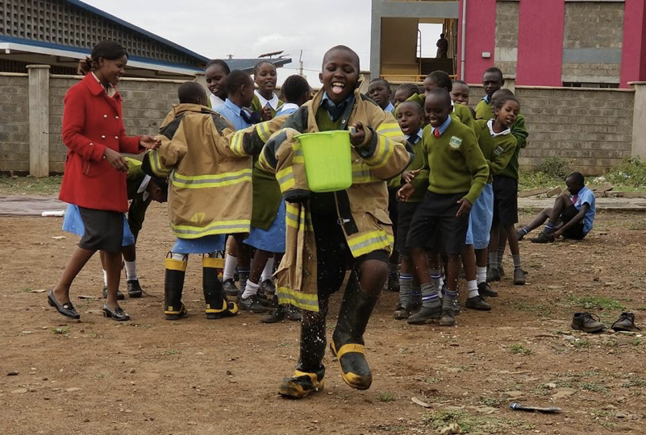

Slide 16
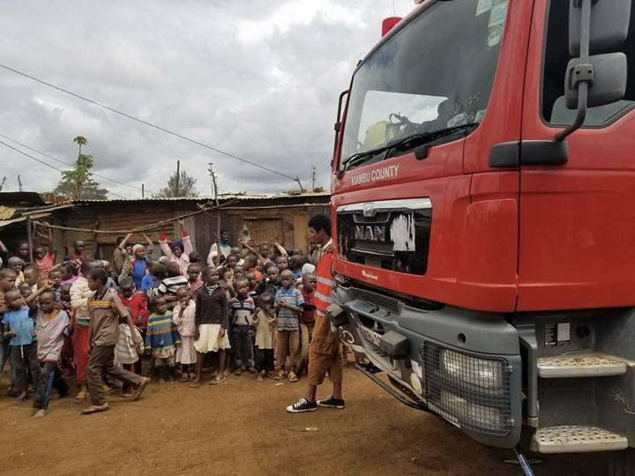
Notes:
Interaction with the firefighters and fire trucks

Slide 17
What is CHE?
Community Health Education or Community Health Evangelism
CHE equips communities to identify needs and mobilize resources to achieve positive, sustainable transformation.
For More information on CHE: www.chenetwork.org

Slide 18
What is CHE?
Community Health Education or Community Health Evangelism
CHE equips communities to identify needs and mobilize resources to achieve positive, sustainable transformation.
For More information on CHE: www.chenetwork.org
AFM’s Fire Safety and Prevention Lessons and Programs are designed to Allow community Members to identify their own programs and solutions to reduce the risk of fires in homes, businesses, Schools and the Community.

Slide 19
An Example:
Safe use of Electricity
Notes:
Purpose: To prevent fires from occurring due to improper use of candles, lamps and other heating and light sources.
Objectives: Participants will understand how to safely use candles, lamps and other heating and light sources.
Overview For Trainers: This lesson has been proven to save lives. You are playing a major role in preventing fires and saving lives and property when you teach this lesson.
This training was originally written for settlement communities in Africa. Please modify stories as needed for your cultural context. You may also want to add additional information regarding available technology like smoke detectors. (our website has additional training materials for various settings – https://www.africafiremission.org/fire-safety-curriculum
Please learn the name of the local fire department and refer to the department by its name in the training when possible. Please give the community the correct number or numbers to call for emergencies in your local area (Fire and Medical emergencies).
Time: 15 min
Story:
The boys, Dan and Dominic, stared at the candle burning on the table in their home. They had become mesmerized by the flickering of the flames. Their sister, Lynn, ran into the room and knocked over the candle. The flame hit a curtain and started a fire.
SHOWD Questions
S – What do you see?
H – What is happening?
O – Does this happen in our place?
W – Why does this happen?
D – What will you do about it?
Method
(trainer: ask these questions)
Time
Knowledge
(trainer: after participants have answered, add on to their answers with this information)
Candle & Lamp Uses
What are some uses for candles & lamps?
5-10 minutes
Candle & Lamp Uses
Lighting living areas.
Starting cooking fires.
Dangers of Candles and Lamps
What are the dangers of using candles & lamps?
What other materials in your home are dangerous for fires?
5-10 minutes
Dangers of Candles and Lamps
A lot of fires that are caused by candles and lamps occur in the living space.
Falling asleep accounts for many of the fires started by candles or lamps.
Combustibles left too close to candles and lamps account for more than half of the fires started by candles and lamps. Combustibles include clothing, curtains, hair, fuel, paper and anything else around that will catch fire.
Playing around or touching the candle or lamp’s flame can also start a fire and is dangerous.
Help the participants think of other things that might be a fire risk in their homes.
Fire Prevention Tips for Candle and Lamp Use
What are ways we can prevent fire in our homes when we use candles or lamps?
5-10 minutes
Fire Prevention Tips for Candle and Lamp Use
Blow out candles or lamps when you leave the room or go to bed.
Keep Candles or lamps at least 12 inches (30 centimeters) away from anything that can burn such as clothing, curtains, hair, fuel, paper.
Ensure children know the dangers of playing with candles, lamps or any kind of fire.
What is the number for contacting the fire brigade in your community?
5-10 minutes
Provide the number for the fire brigade and other emergency services.
Summary:
Think back to the story at the beginning of this lesson, what could have prevented the fire in the story?
What have you learned that you can teach others in preventing fires?
5-10 minutes
Summary:
Children are not the only ones who love to watch fire. Adults will catch themselves staring at fire from time to time.
Since the dawn of time man has been using fire to cook with, light their houses and warm their living areas.
Candles and lamps can be dangerous if you don’t pay attention. The same flames that help us can also become a nightmare.
Unattended candles and lamps have been known to start fires that can easily burn not only your living space, but many other’s as well. However, if we are diligent around candles and lamps we can take steps to prevent fires from occurring in our community.
Families would do well to talk to each other about the dangers of open fires and be thankful for the blessing that fires provide.
Attitude: Facilitator understands the role of candles, lamps and other heating and light sources for lighting purposes and how to properly use them.
Skill: Participants will be able to discuss how to use candles and lamps and how they can be dangerous.
Evaluation: Participants should be able to name ways to safely use candles and lamps to prevent dangerous fires. Participants will know how to contact the fire brigade in case of fire.
Materials: Newsprint, Markers, Emergency Numbers

Slide 20
What’s the impact of Effective Community Fire Safety and Prevention programs?
YouR Community
An Example from Kenya

Slide 21
www.AfricaFireMission.org

